Slide 1
ADVANCED COMPUTER NETWORKS
Aziz Abushark 20332134

Slide 2
Securing The Cloud
Hi

Slide 3
01
Requirements
Assignment 2

Slide 4
Develop a secure cloud storage application for Dropbox, Box, Google Drive, Office365
your application will secure all files that are uploaded to the cloud, such that only people that are part of your “Secure Cloud Storage Group” will be able to decrypt uploaded files
Any member of the group should be able to upload encrypted files to the cloud service. To all other users the files will be encrypted
Handle multiple requests simultaneously by implementing a threaded server

Slide 5
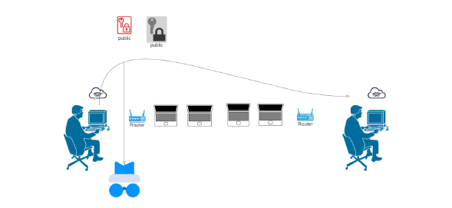
Protocol Design The goal of this to design and implement a suitable key management system for your application which employs public-key certificates that allows users of the system to share files securely, and also allows one to add or remove users from the group. You are free to implement your application for a desktop or mobile platform and make use of any open-source cryptographic libraries.

Slide 6
Implementation
This code implements a simple GUI application for secure cloud storage using Google Drive. The application allows the user to authenticate with their Google Drive account and then upload, download and decrypt files securely. The program uses RSA public-key cryptography to encrypt and decrypt the files and make the use of end-to-end encryption.
The main.py file contains the code for the GUI and uses the tkinter module to create the interface. It also imports User and SecureCloudStorage classes from user.py and secure_cloud_storage.py, respectively.
The User class in user.py defines the attributes of a user, such as email, credentials, public and private keys, and provides methods to generate a new RSA key pair.
The SecureCloudStorage class in secure_cloud_storage.py defines methods for adding and removing users, encrypting and decrypting data using RSA, and uploading and downloading files from Google Drive using the Google Drive API.
Overall, the code provides a simple and secure way to store files in the cloud using encryption and public-key cryptography.

Slide 7
Thank you for watching

